Slide 1
Texas Community Development Block Grant Program
CDBG Over Coffee
Today’s Topic:
Financial Management System Self-Assessment (FMSSA)
Notes:
Good afternoon and thank you for joining us for another TxCDBG Over Coffee.
My name is Chad Hinds and I am the Assistant Director for the State CDG Program.
Today we will be talking about the Financial Management System for Self-Assessment or FMSSA, for short.
So grab that 2PM cup of coffee ‘cause here we go.

Slide 2
Background
Applicants must demonstrate financial capacity
Previously, TDA required copy of applicant’s annual audit with application submission.
NEW 2023 awards: Applicants to complete FMSSA form
Notes:
As you all may know, TxCDBG applicants must demonstrate financial capacity to ensure that grant funds are used appropriately and with sufficient local oversight.
In the past, a copy of the grant applicant’s most recent annual audit was required as to be submitted with the application as an eligibility requirement.
For the 2023 round we have a new policy for applicants to complete the FMSSA. With this new process, the audit is a factor in evaluating an applicant’s financial capacity but it’s not strictly an eligibility requirement.
Instead, the applicant’s financial self-assessment determines if they have adequate financial controls or if additional oversight may be required.
Thus, the evaluation of the FMSSA is more of a “what does it take to get to award” review.

Slide 3
What is the FMSSA Form?
The form:
Is designed to assist in providing financial process information
In accepting CDBG funds the Grant Recipient:
Must demonstrate sound financial management
May be required to adopt additional controls
Notes:
The Financial Management System Self-Assessment form itself is designed to assist the Grant Recipient in providing information on their financial processes and who is the responsible person for such processes.
As part of the award process, the FMSSA must be completed by applicants and used by TDA in risk analysis prior to the release of the grant agreement for execution.
The FMSSA is a Performance Report, for those of you familiar with the structure of TDAGO, this is as a sub-document to the grant agreement and it is generated in TDA-Go after notification of the award is made.
The Grant Recipient should complete this self assessment as soon as possible so that it can be submitted and reviewed by TDA to evaluate the community’s existing processes before a grant agreement will be released.
Based on TDA’s review, the FMSSA will either be accepted, a Special Condition may be made to the grant agreement to enhance oversight, or other action as determined by TDA.

Slide 4
Who completes the FMSSA Report?
All users assigned to the application
The form must be certified by the Authorized Official (AO)
Consultants may assist
Notes:
All users assigned to the application (or the parent document in TDA-GO parlance) will automatically be added to the FMSSA with the same permissions to edit.
As this is a Performance Report, specific to a single grant, the Authorized Official, local staff, and consultants assigned to the application will also be assigned to the FMSSA.
Consultants may assist in the preparation of the report but ultimately the Authorized Official must certify the information is correct and submit it for review in TDAGO.

Slide 5
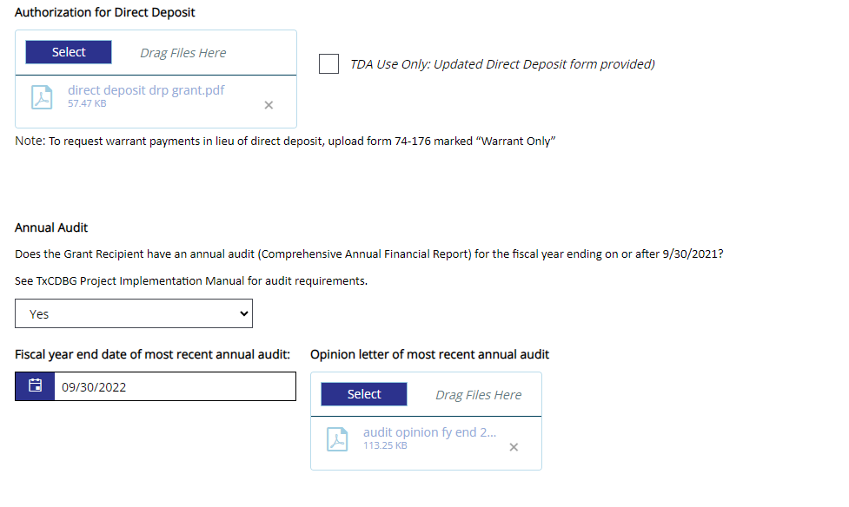
The Form in TDA-GO
Notes:
Here is a screenshot of the top of the FMSSA.
Here we have a field to upload the Authorization for Direct Deposit. Specific instructions for completing the Direct Deposit form may be found in the TxCDBG Implementation Manual. Some of the common errors we are seeing include, entering information in the wrong fields, not checking the correct check-boxes or checking any at all, and not signing on the appropriate signature line.
In the next section, we have a field for the community’s most recent audit. Please note that a date has been added to the Yes/No drop-down question.
So, if the applicant has an annual audit for the fiscal year ending on or after 9/30/2021 they would select “Yes” and if not, then “No”.
You may have noticed that selecting “Yes” changes the number of questions required. So, if you have a recent audit, there is less information required to complete the FMSSA versus communities that do not.
The next question asks which year the applicant’s most recent annual audit is from and provides a spot for upload. Please note that even if the applicant does NOT have an audit on or before 9/30/21 and answers “No”, they still need to upload the most recent audit in this field. The age of the most recent audit will be evaluated as part of TDA’s review process. This is an omission that we are seeing on some submissions, so regardless of which fiscal year the applicant has an audit for, it will still need to be uploaded to complete the FMSSA.

Slide 6
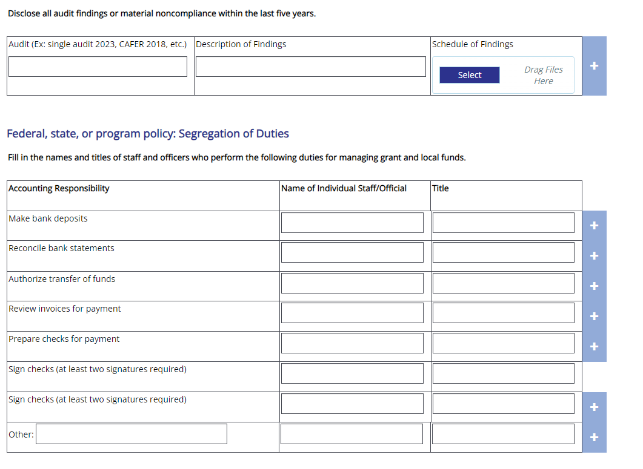
The Form – Continued
Notes:
The FMSSA continues with a question about any findings of material non-compliance within the last five-years. This one is pretty clear, any findings during this five-year period should be identified here by both the audit year and type and a short description of those findings, including a place to upload the referenced document.
Next, we have a block of fields to enter the names and roles of individuals involved in managing grant and local funds. Please note that this is not meant to be a CDBG specific segregation of duties, but the actual duties assigned to persons at the local level. This part of the FMSSA will be evaluated by TDA to ensure that there is an appropriate segregation of duties.
We know that for some of our communities, especially the smaller ones, there may be few local staff performing these duties, but if you just put the City Secretary’s name for every responsibility, expect to get an email from TDA staff asking for clarification.
Also, I want to point out that there are “plus signs” available if you do need to add additional names and roles.

Slide 7
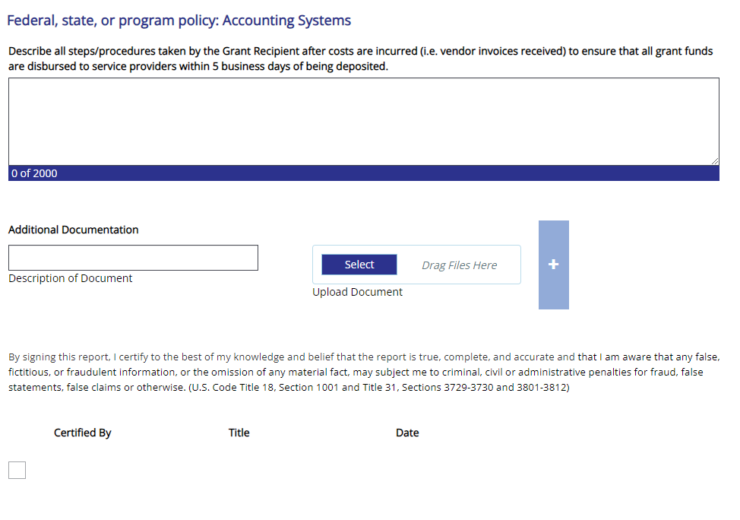
The Form – Continued
Notes:
So, for those communities that answered Yes to having a recent audit, this is the last question you will have on the FMSSA. What TDA is looking for here is a description of how the grant recipient plans to ensure the timely disbursement of funds, that is disbursement within 5 business days of deposit. The most complete answers here should include information about:
How are deposits tracked? Is someone monitoring the bank deposits on a daily basis or is it only intermittently? Intermittently or even just weekly will require further explanation or a change in process.
Does the community pay invoices out of General Revenue and only makes payment requests as needed? If payment requests are only made for reimbursements, then timeliness becomes less of a concern.
The reviewer should be able to read the narrative here and understand how the community processes payments and will do so in a timely manner. Failure to do so will likely require follow-up from TDA.
As I mentioned before, anyone “added” to the application when the FMSSA Performance Report is generated will be allowed to add and edit the FMSSA, but only the Authorize Official, or AO can submit it to TDA for review. Remember that in TDAGO, Save is not the same thing as submit, so until the AO makes the status change to “Submitted” TDA will not see the report for review and the next steps in executing the grant agreement may be delayed.

Slide 8
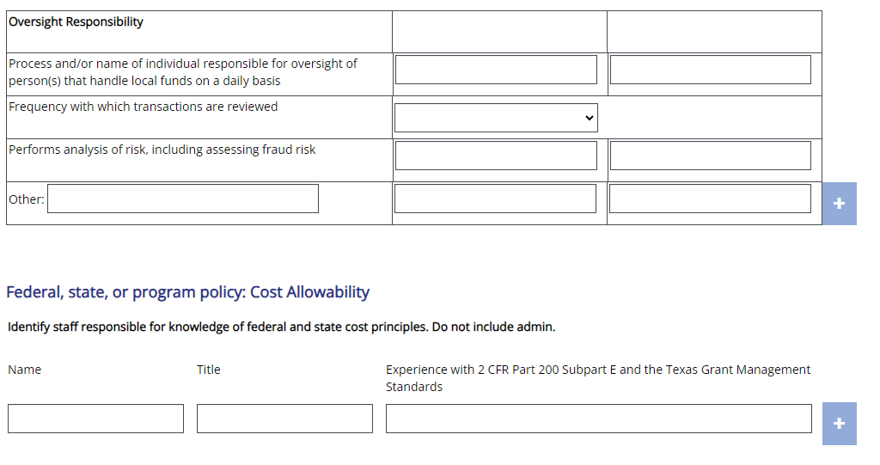
The Form – Continued
Notes:
For those communities that answered “No” to the question regarding having a recent audit, the FMSSA will continue with the Oversight Responsibility section on your screen now. Here we are looking for information regarding the person or persons responsible for the daily oversight of the community’s financial affairs, including how often this oversight occurs, who assesses fraud risks, and any additional oversight that is performed at the local level.
Next, we are asking about the persons or persons with a knowledge of federal and state cost principles.
We are not looking for the administrator’s experience with costs principles, but who at the local level has experience with these rules and regulations.

Slide 9
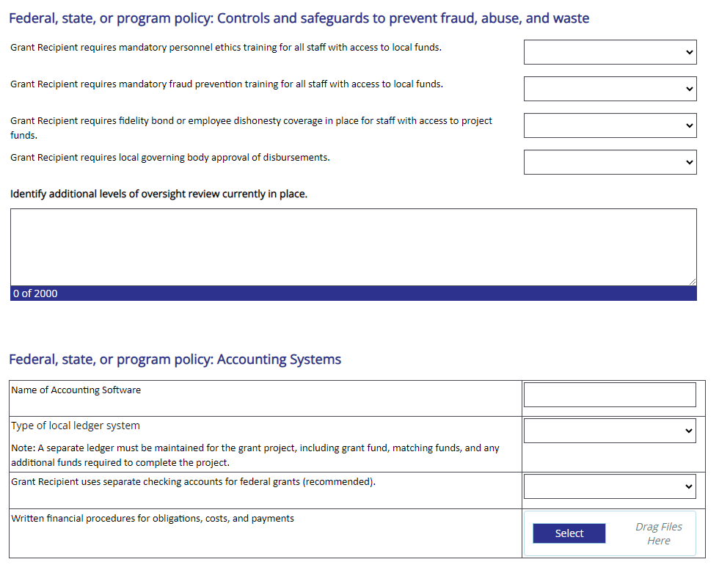
The Form – Continued
Notes:
Continuing on, we have a series of Yes/No questions about additional safeguards at the local level, including trainings, bonding requirements, approval of disbursements and any other local levels of oversight. Obviously, “Yes”s are preferred here, but you should answer based on the actual controls in place.
Next, a few questions about the local accounting system, separate checking accounts for grant funds, and any written standard operating procedures. Again, this is not intended to capture a TxCDBG grant specific process, but the actual system used at the local level.

Slide 10
When is the FMSSA due?
Must be completed and submitted as part of the pre-award process
The final grant agreement cannot be routed for executed
Notes:
When is the FMSSA due?
Well frankly, since submission of the FMSSA is required prior to the release of the grant agreement for execution, it should be completed and submitted to TDA as soon as possible.

Slide 11
Potential Outcomes
No additional controls required
Additional role documentation
Additional oversight on payments
Requiring a third party to manage grant funds for high-risk communities
Notes:
I touched on this briefly at the start of this CDBG Over Coffee, but once the FMSSA is reviewed and the risk factors identified by TDA, there are a few potential outcomes before moving forward with execution of the grant agreement.
1. No additional controls required.
2 . Additional documentation of authority or separation of duties.
3. Additional oversight on payments.
4. Requiring a third-party/partnering local government manage grant funding for high risk community
So the key take-away is that when completing the FMSSA, understand what is being asked and answer accordingly, complete all applicable fields, and be sure to upload your most recent audit, even if it is prior to FY 2021.

Slide 12
Thank You For Your Attention
Time for Questions

